Slide 1
The MBE as an Equation of a Straight Line

Slide 2
Havlena and Odeh (1963) expressed Equation 11-15 in the following form:
no pressure maintenance by gas or water injection is being considered,

Slide 4
in the case of a reservoir which has no initial gas cap (i.e., m = 0) or water influx (i.e.,
We = 0), and negligible formation and water compressibilities (i.e., cf and cw = 0), Equation 11-25 reduces to:

Slide 5
The Straight-Line Solution Method to the MBE

Slide 6
Case 1. Volumetric Undersaturated-Oil Reservoirs

Slide 7
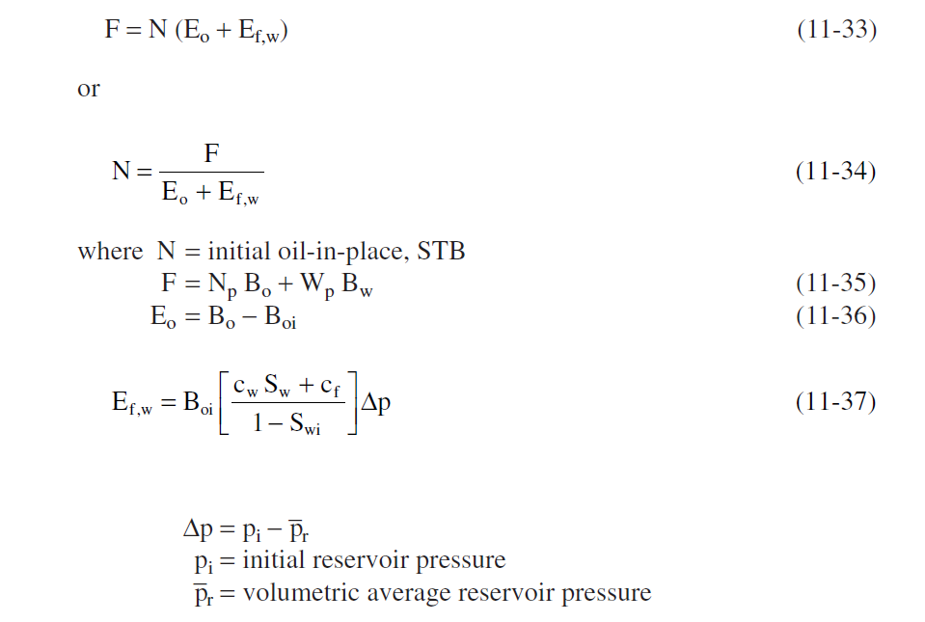

Slide 8
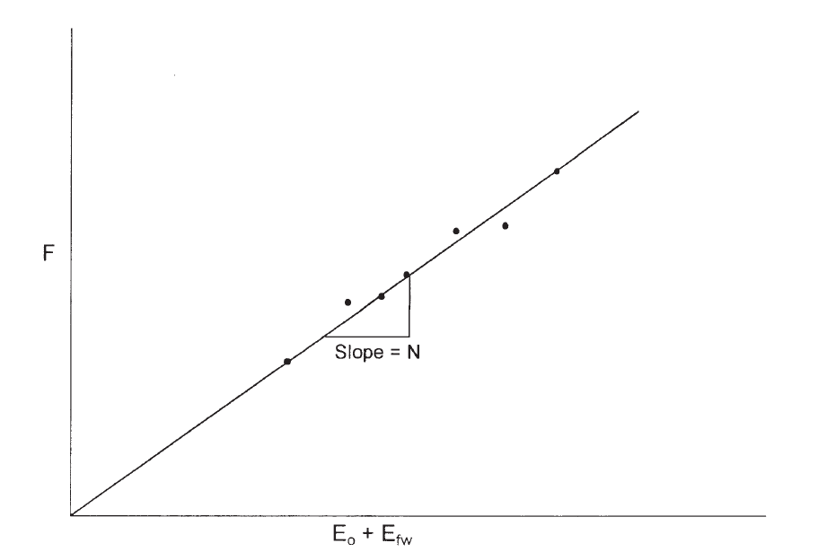

Slide 9
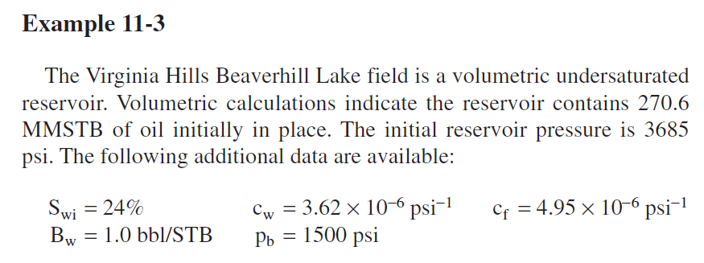

Slide 10
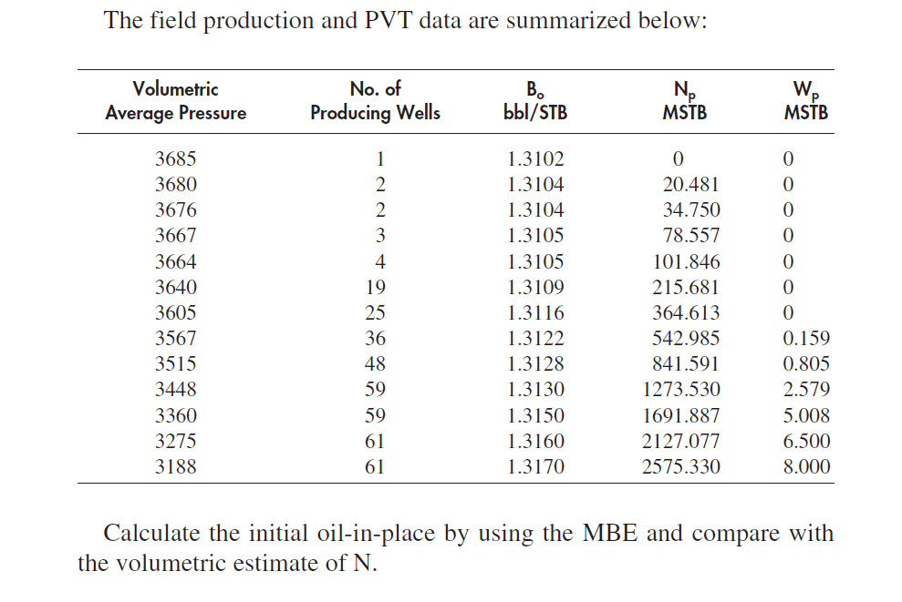

Slide 11
Case 2. Volumetric Saturated-Oil Reservoirs
Assuming that the water and rock expansion term Ef,w is negligible in comparison with the expansion of solution gas, Equation 11-32 can be simplified as:
Your turn to find out

Slide 12
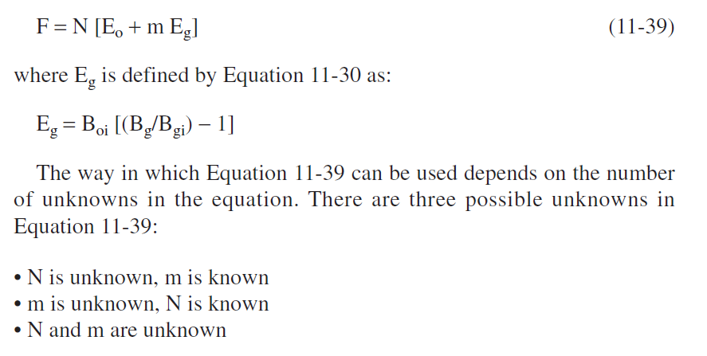
Case 3. Gas-Cap-Drive Reservoirs

Slide 13
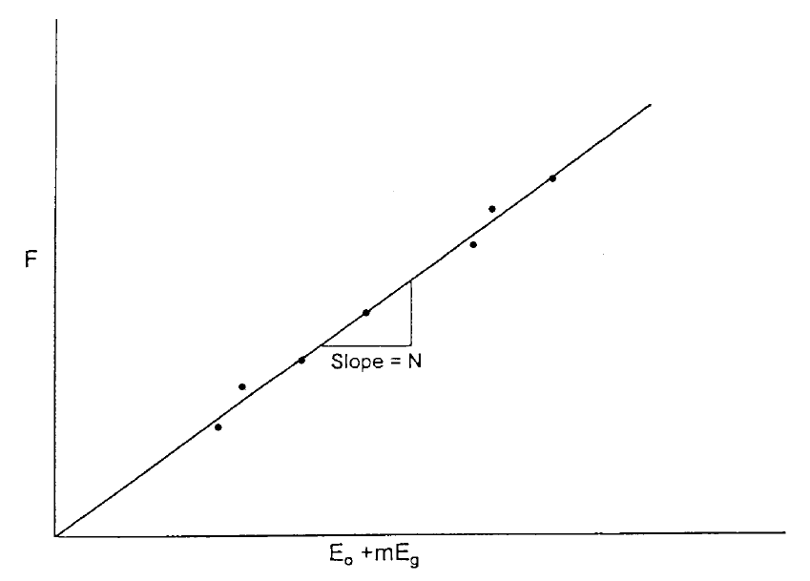
a. Unknown N, known m:

Slide 14
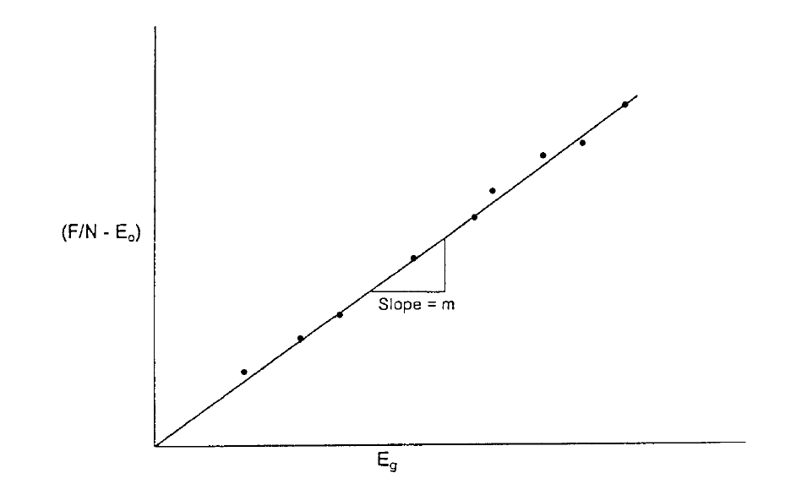
b. Unknown m, known N:

Slide 15
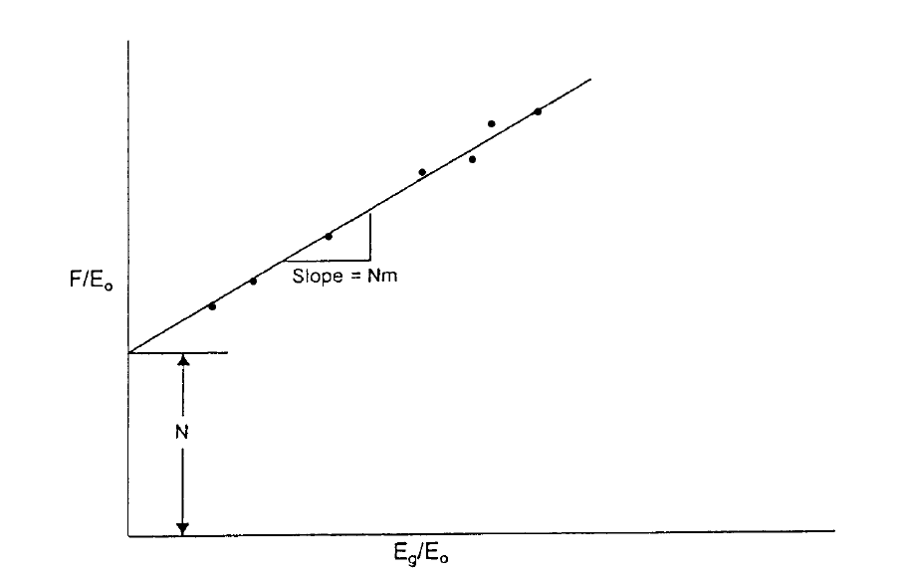
c. N and m are Unknown

Slide 16
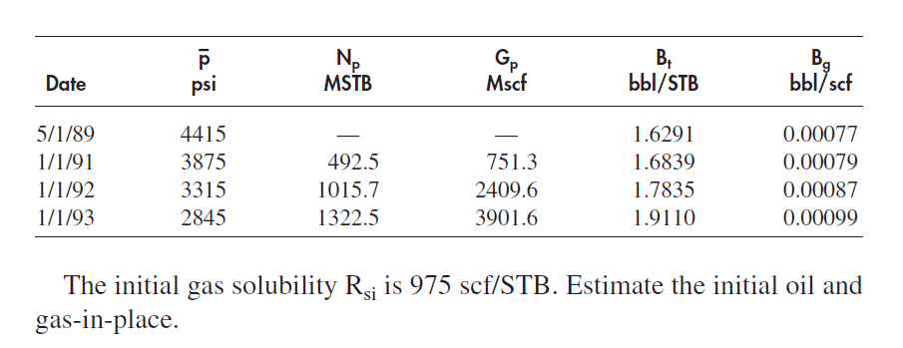

Slide 17
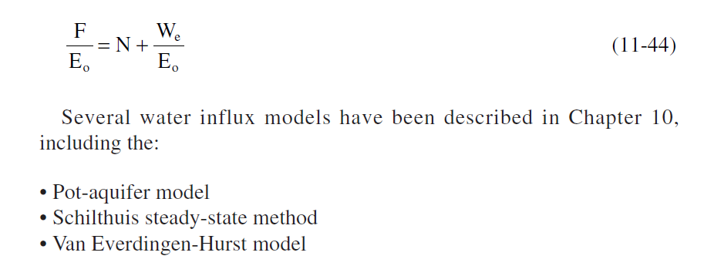
Case 4. Water-Drive Reservoirs

Slide 18
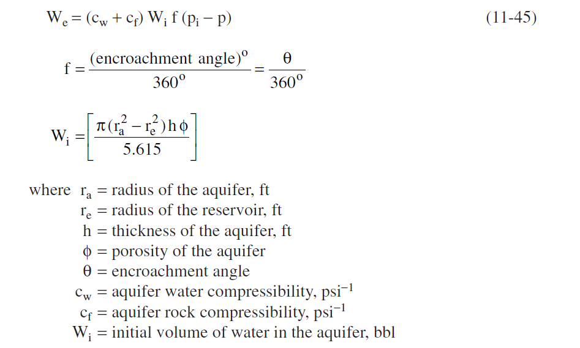
The Pot-Aquifer Model in the MBE

Slide 20
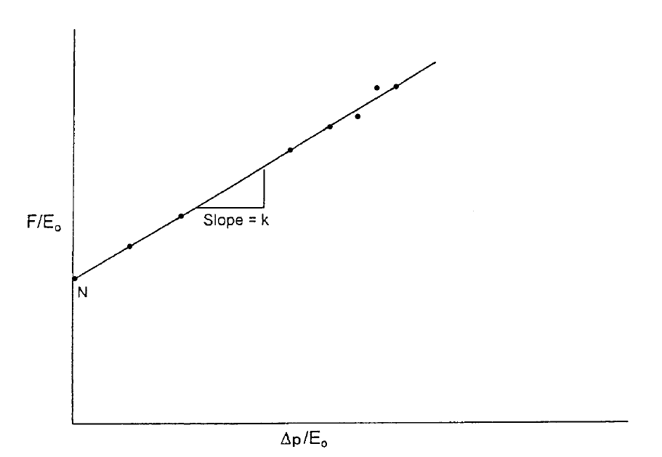

Slide 21
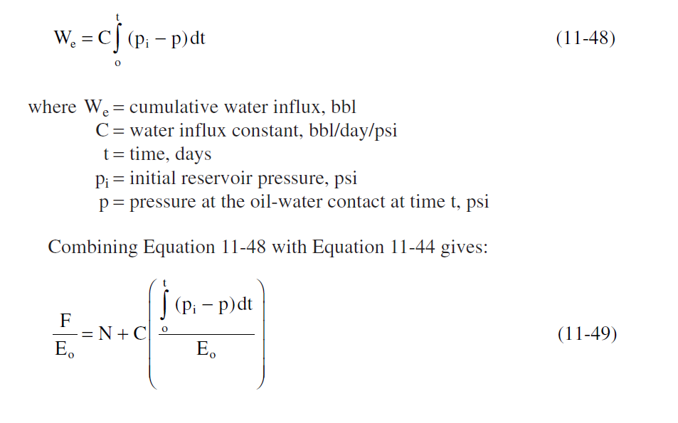
The Steady-State Model in the MBE

Slide 22
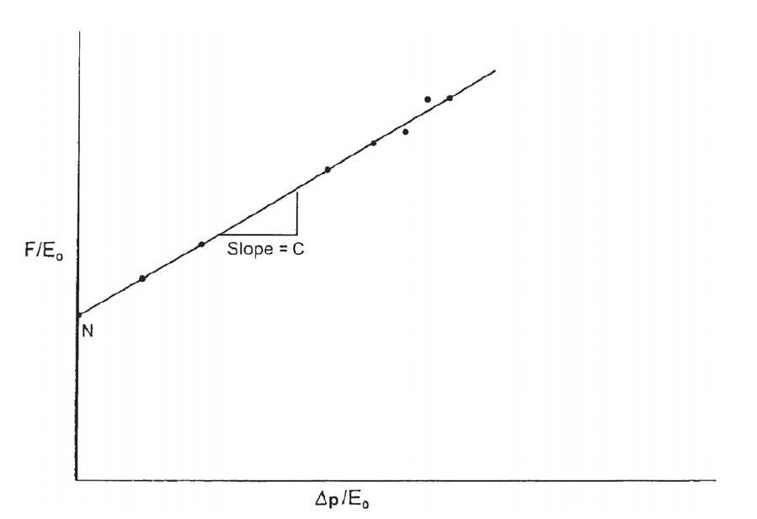

Slide 23
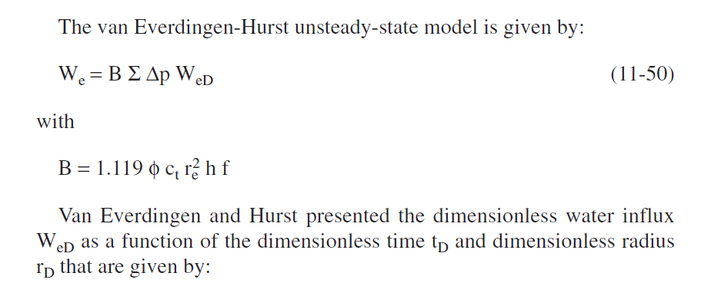
The Unsteady-State Model in the MBE

Slide 24
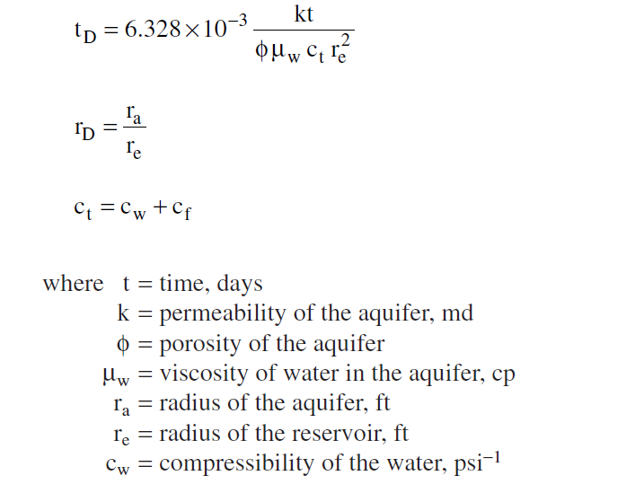

Slide 25
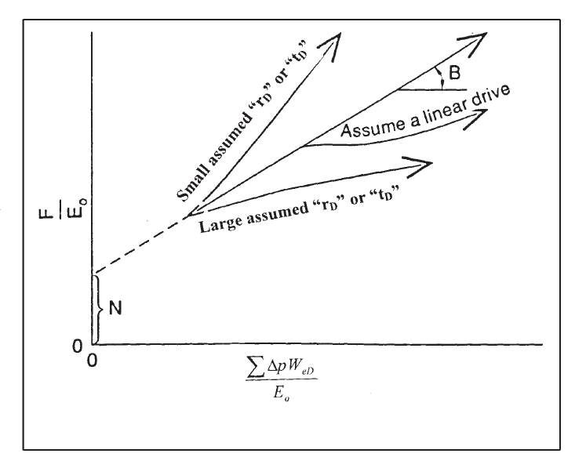

Slide 26
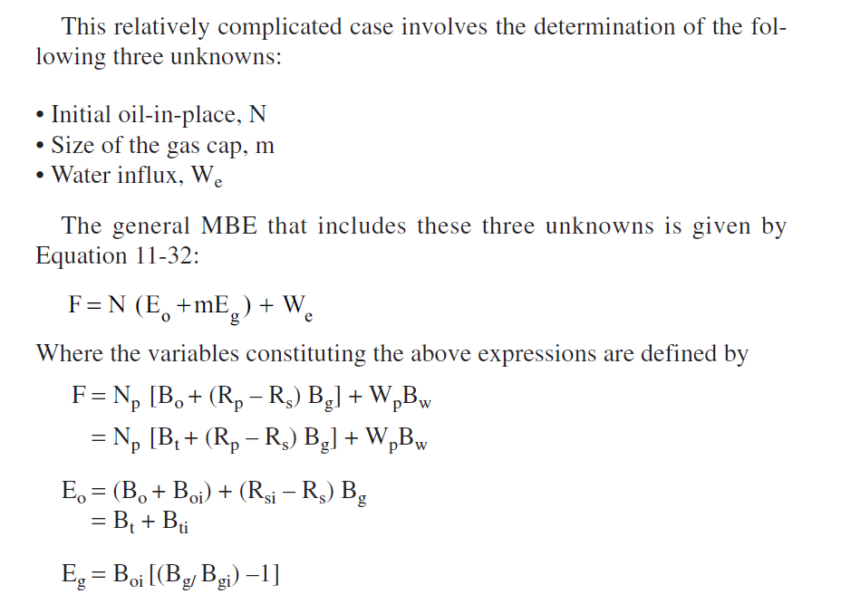
Case 5. Combination-Drive Reservoirs

Slide 27
Case 6. Average Reservoir Pressure
Your turn to find out

Slide 28
See you next time
HAVE A NICE TIME

